Slide 1
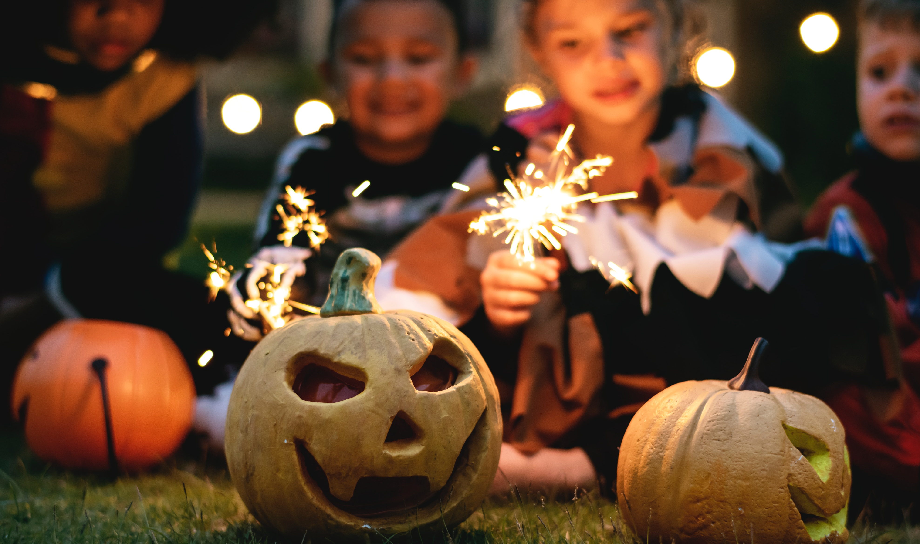

All About Halloween!
© 2019 Autism Speaks Inc.
Autism Speaks and Autism Speaks Design are registered trademarks owned by Autism Speaks Inc. All rights reserved.

Slide 2
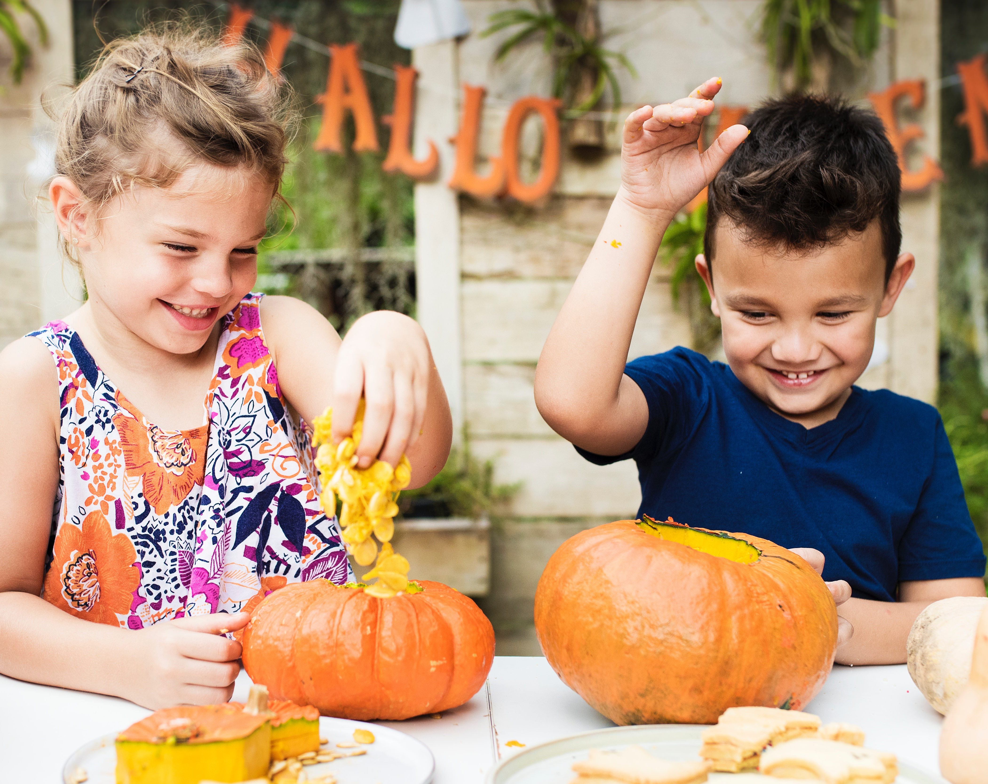
Halloween is a fun holiday!
Halloween happens every fall on October 31.
There are lots of ways to celebrate Halloween, like carving pumpkins and wearing costumes! Lots of people go trick-or-treating, too.

Slide 3
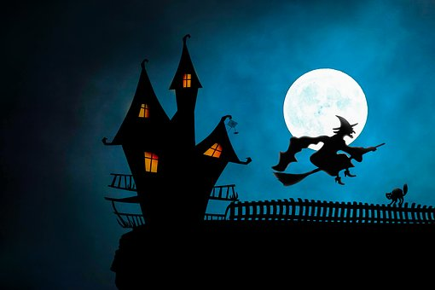
Some Halloween things can be scary.
Ghosts and witches are popular at Halloween. There may be lights and things that move, too. These things may make me feel nervous or scared.
I can remember that these are just pretend.
It's OK if I don't want to see or do things that are scary.

Slide 4
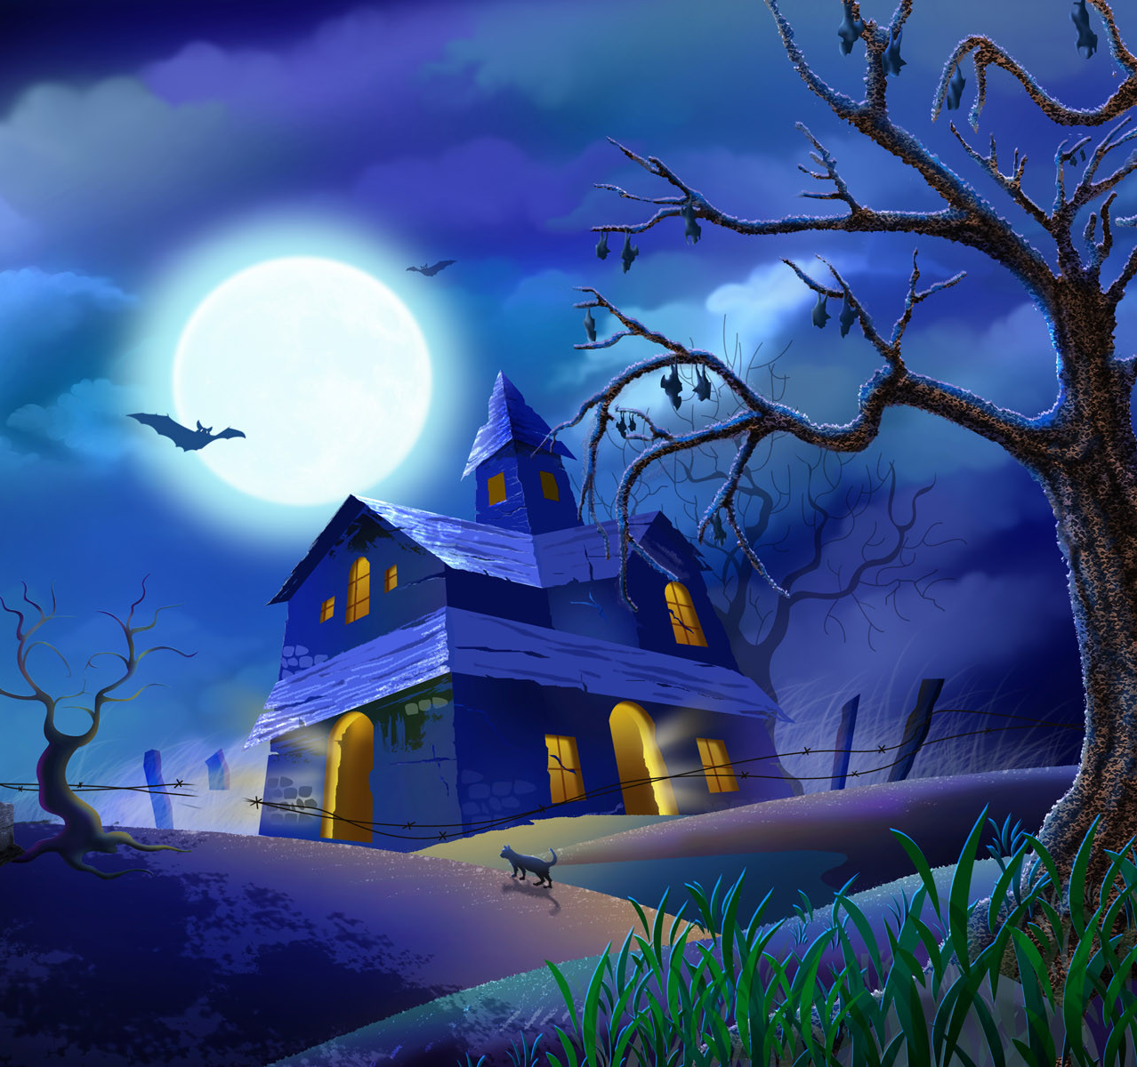
I may hear loud noises and sounds too.
Haunted houses and even Halloween stores can have sounds, like loud music and voices, that I don't like.
I may hear these sounds when I'm trick-or-treating, too.
The sounds are pretend. But they may make me nervous or scared.
If I don't like the sounds, I can wear headphones or earplugs. I also can ask to go home.

Slide 5
At Halloween, lots of people carve pumpkins.
Insert a picture of a carved or painted
pumpkin that you like.
Pumpkins carved with faces are called jack o’ lanterns. Pumpkins also can have pictures painted on them.
I need to be with an adult to carve a pumpkin.

Slide 6
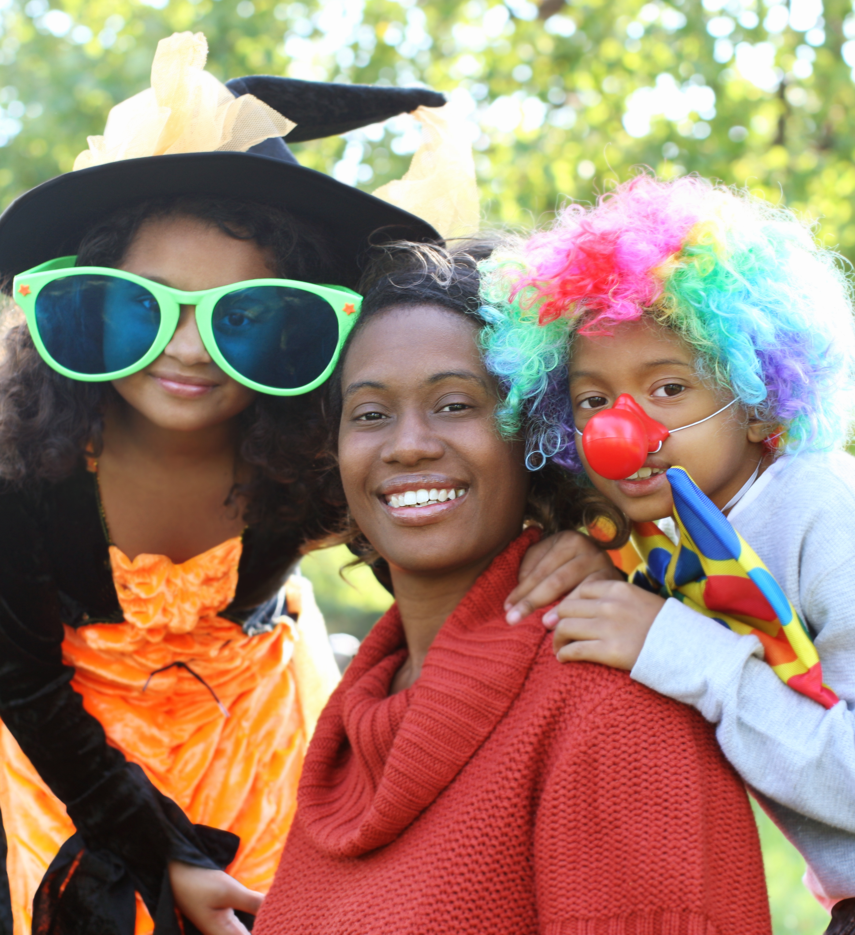
On Halloween, many people wear a costume.
Some costumes are funny. And some are pretty.
But some can be a little scary.

Slide 7
What do I want to wear for Halloween?
Insert a picture of what you
want to wear on Halloween.
I can be my favorite character, an animal or even just me!
If I don’t want to wear a costume, it's OK. I can wear my normal clothes. Or I can wear Halloween colors, like orange and black.
Or I can wear a special Halloween shirt.

Slide 8
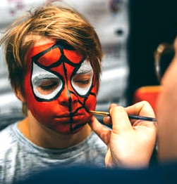
Some people wear a mask or face paint with their costume.
A mask and face paint can cover someone’s face. This can make it hard for me to see who the person is.
If I’m confused, I can ask an adult who I trust.
I’ll remember that under the mask or paint, it’s just a boy or
girl like me.

Slide 9
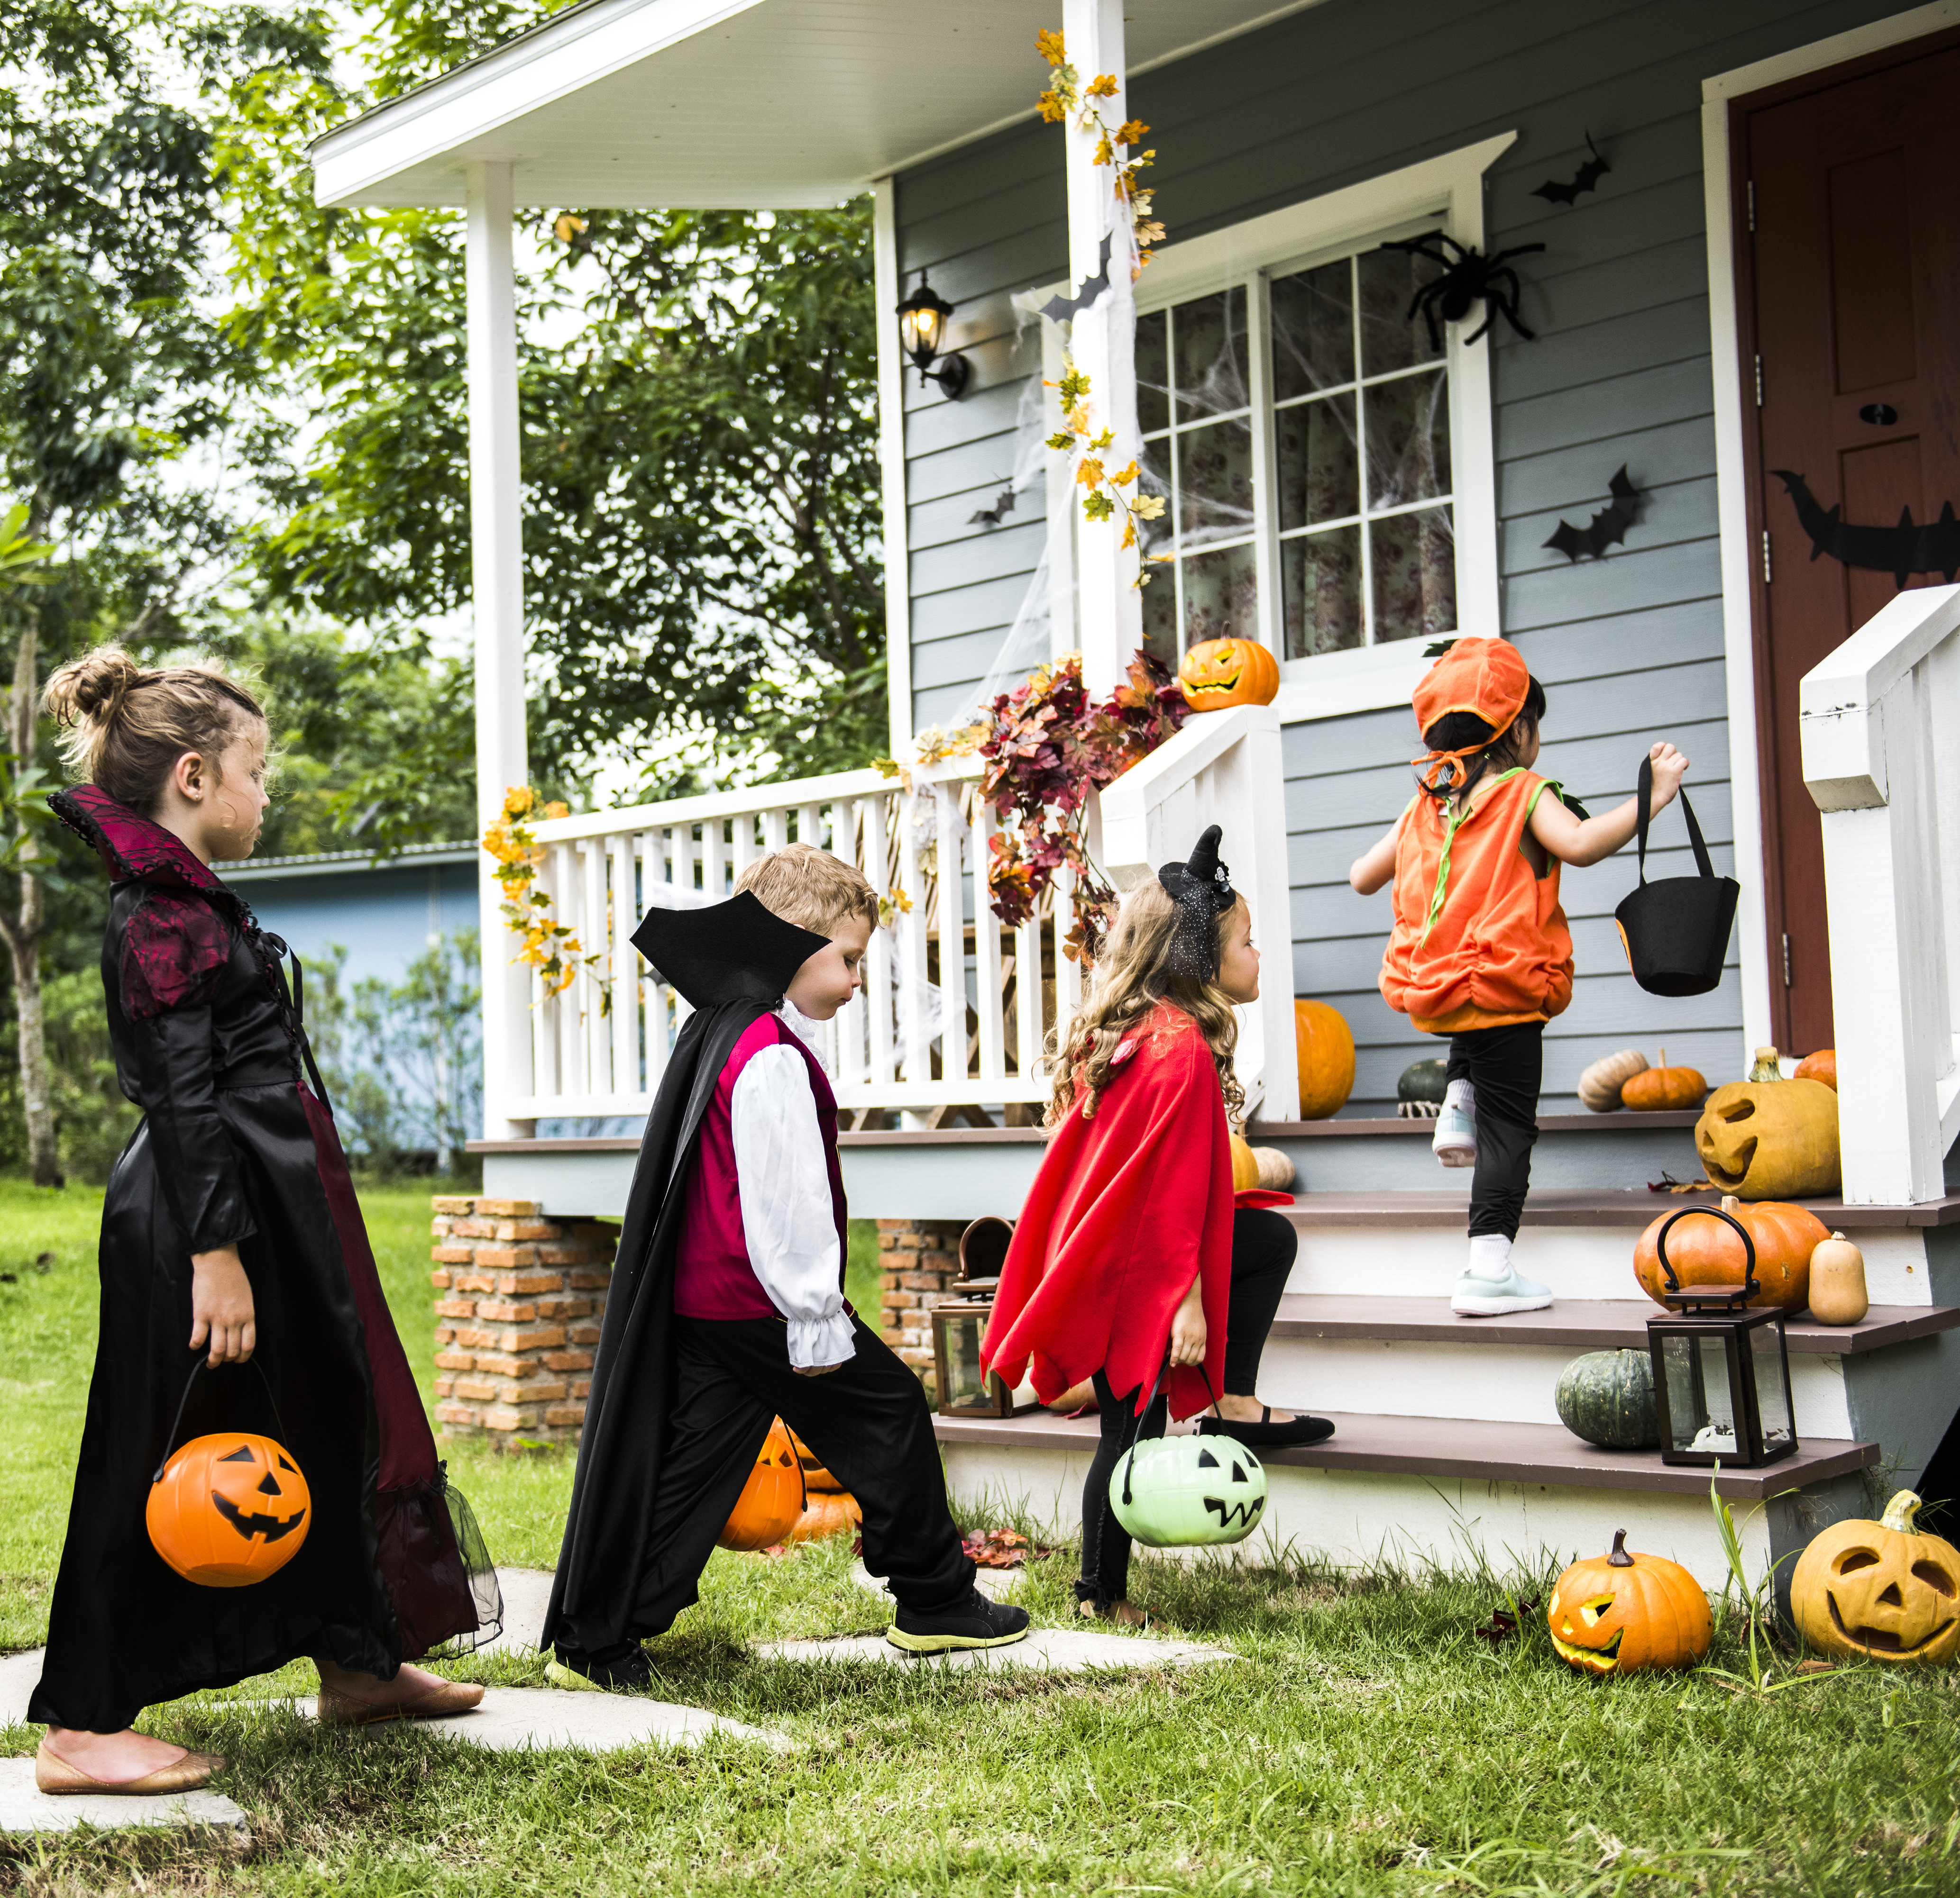
Lots of people go trick-or-treating on Halloween.
Trick-or-treating can happen in a neighborhood, in an office or apartment building or even in a shopping center.
People go to the door and say “trick or treat" to get candy.
If no one's there, they may leave a bowl of candy at the door. I can take a piece.

Slide 10
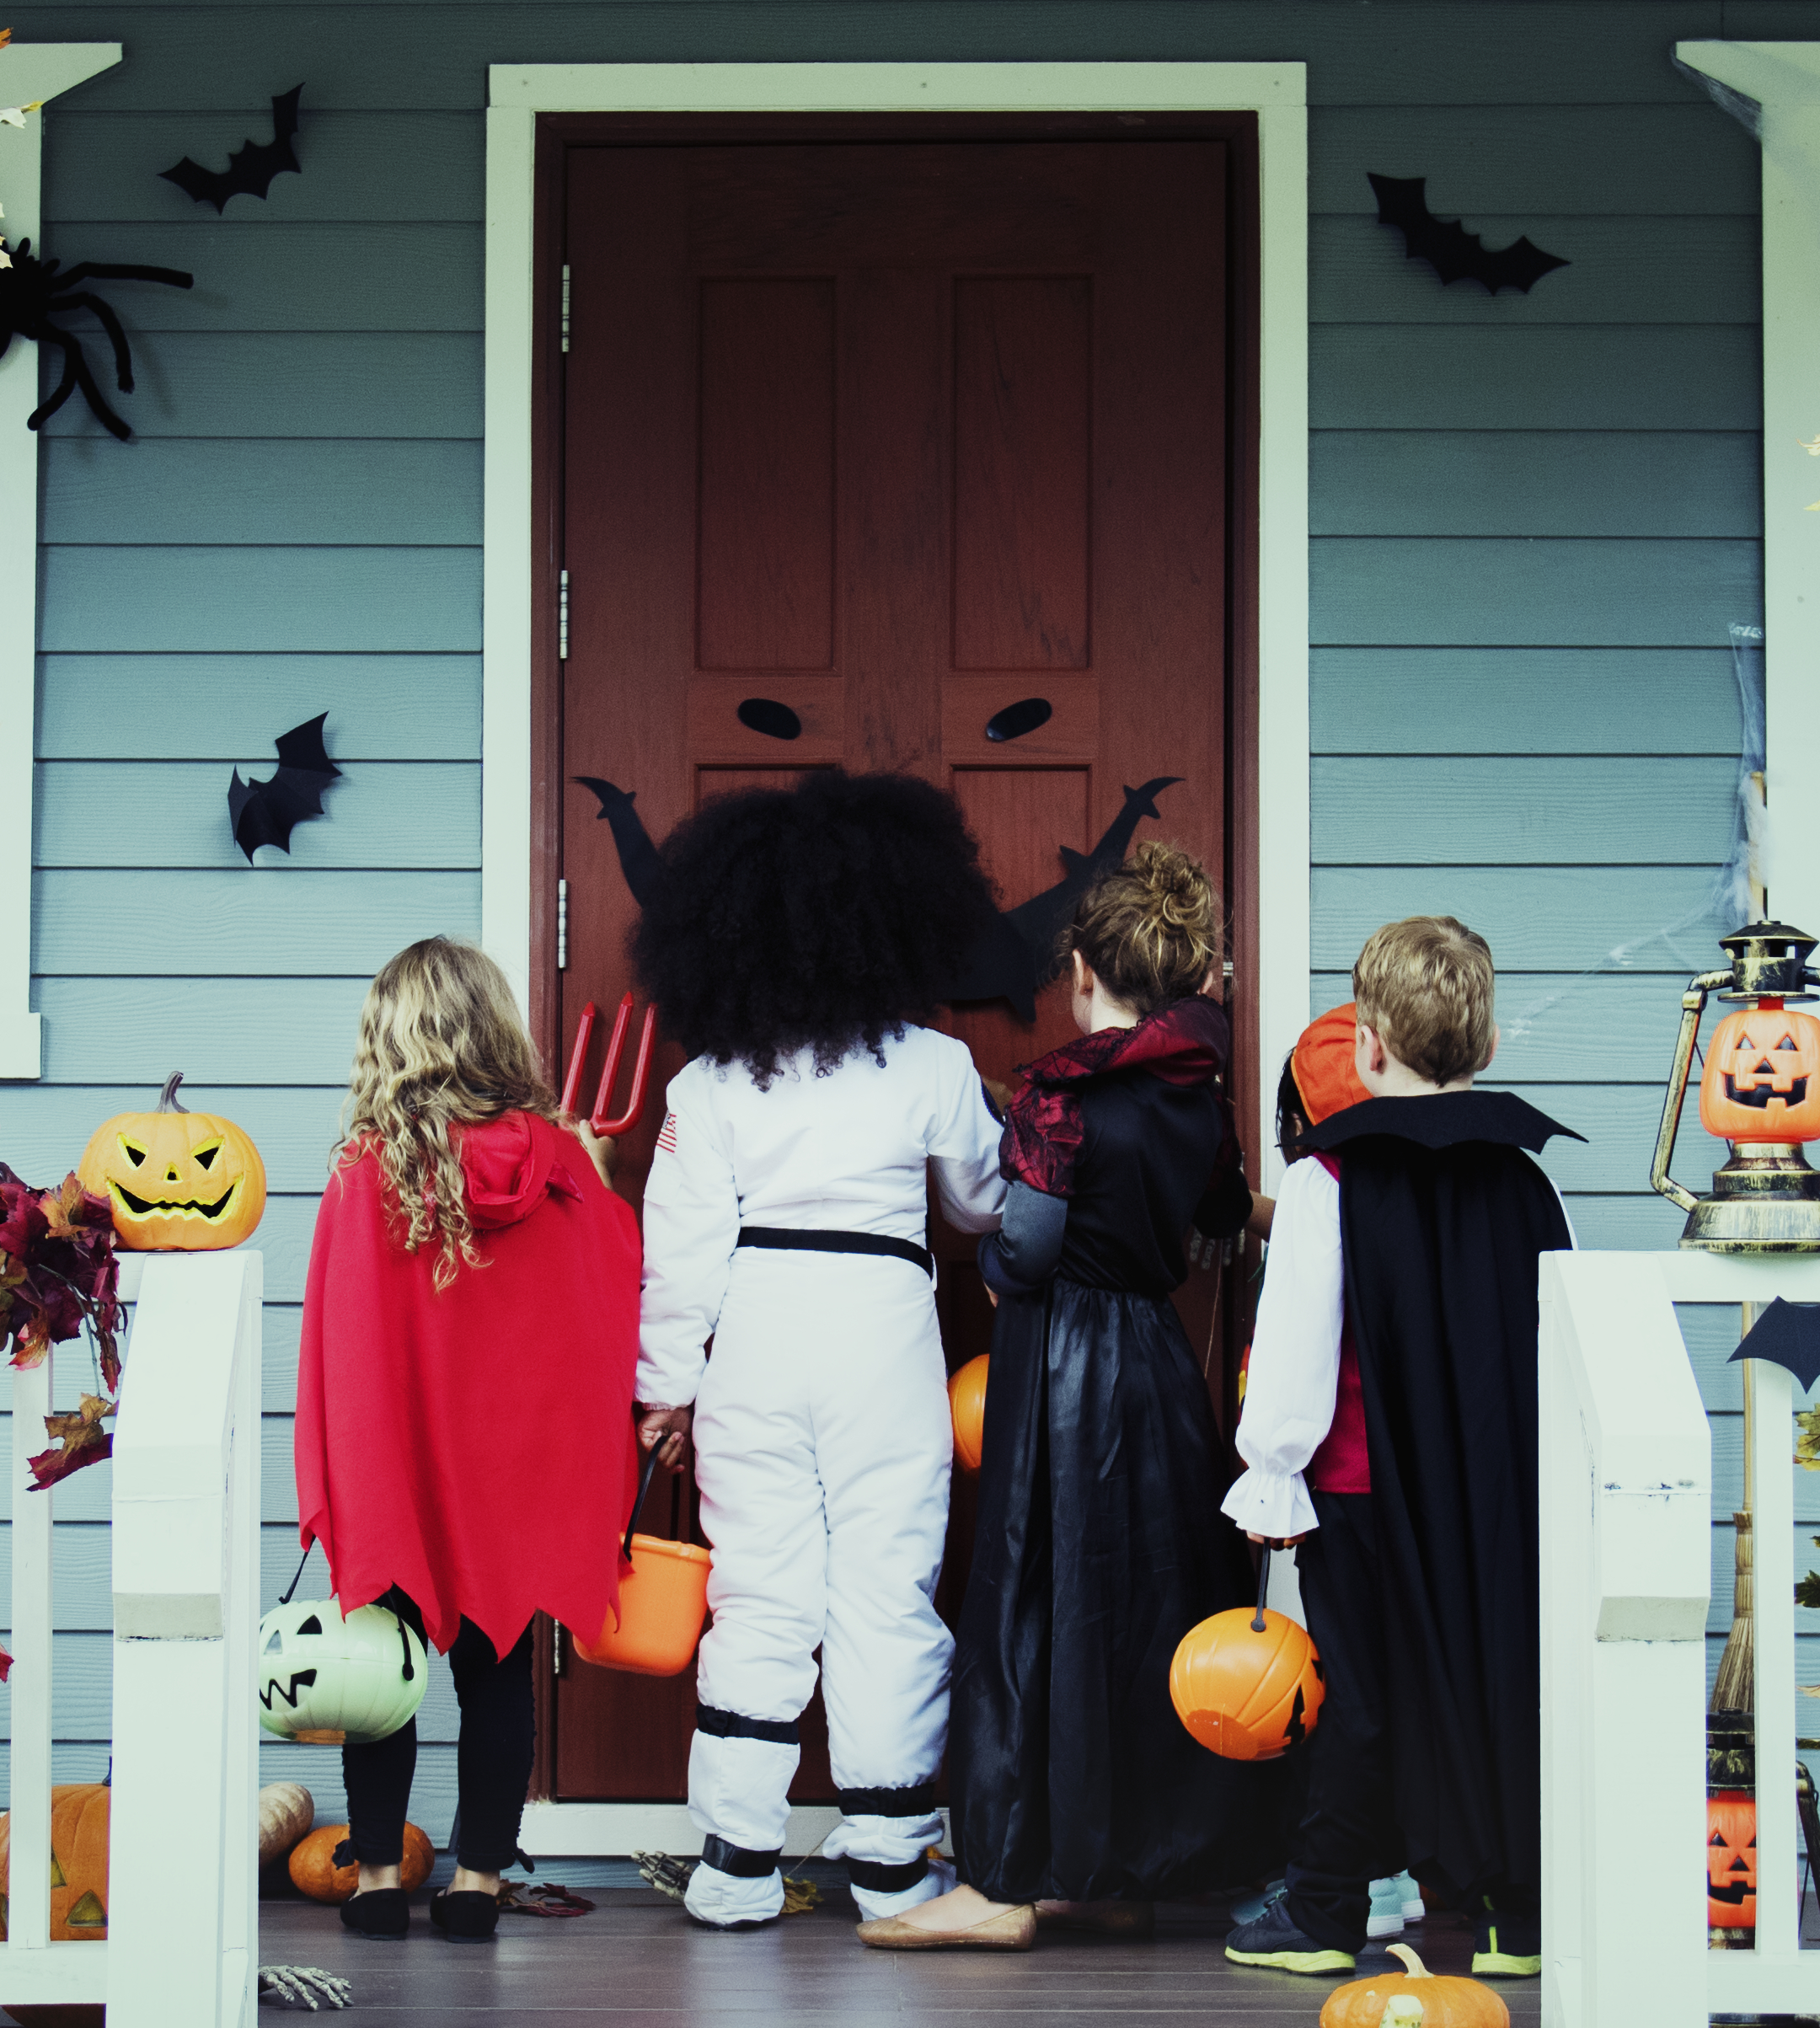
Here's what happens at trick-or-treating.
The person at the door gives
out treats, snacks or a small toy.
I can carry the things I get in a bag or a bucket.
Once I get my treat, I say,
“Thank you.”
Don’t worry, there aren’t really
any tricks!

Slide 11
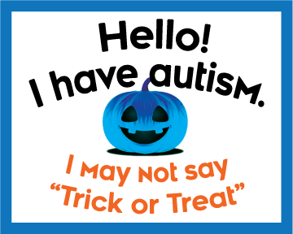
I don't have to say "trick or treat."
If I want to, I can wear a
special badge or carry
a bag with a sign to let
people know that I may communicate differently.

Slide 12
I don’t have to go trick-or-treating to have fun on Halloween.
Insert a picture of other things
to do on Halloween.
I may see and hear things during trick-or-treating that I don’t like. These can make it hard for me to have fun.
If I don't want to go out, I
can stay home and help give out treats.
I also can read a book or watch a movie instead.

Slide 13
Things I can try
If I want to wear a costume, I can try it on a few times before Halloween to make sure I feel OK in it.
If my friends are wearing masks, I can ask them to take the mask off so I can see who they are. Then they can put it back on.
If I'm trick-or-treating, I can stay in my neighborhood or where I feel safe.
If I don't like being out at night, I can celebrate Halloween during the day.
If I don't like certain sounds, I can wear ear plugs or headphones. I also can ask to go home.

Slide 14
My Halloween plans
Write about what you plan to do on Halloween.
On Halloween I plan to…

Slide 15
About Autism Speaks
Autism Speaks is dedicated to promoting solutions, across the spectrum and throughout the life span, for the needs of individuals with autism and their families. We do this through advocacy and support; increasing understanding and acceptance of people with autism spectrum disorder; and advancing research into causes and better interventions for autism spectrum disorder and related conditions.
To find resources, join an event or make a donation, go to AutismSpeaks.org.
Learn more by following @AutismSpeaks on Facebook, Twitter, Instagram and LinkedIn.
We Are Here To Help
Autism Response Team: 1-888-AUTISM2
Español: 888-772-9050
FamilyServices@AutismSpeaks.org
© 2019 Autism Speaks Inc.
Autism Speaks and Autism Speaks Design are registered trademarks owned by Autism Speaks Inc. All rights reserved.

